Slide 1
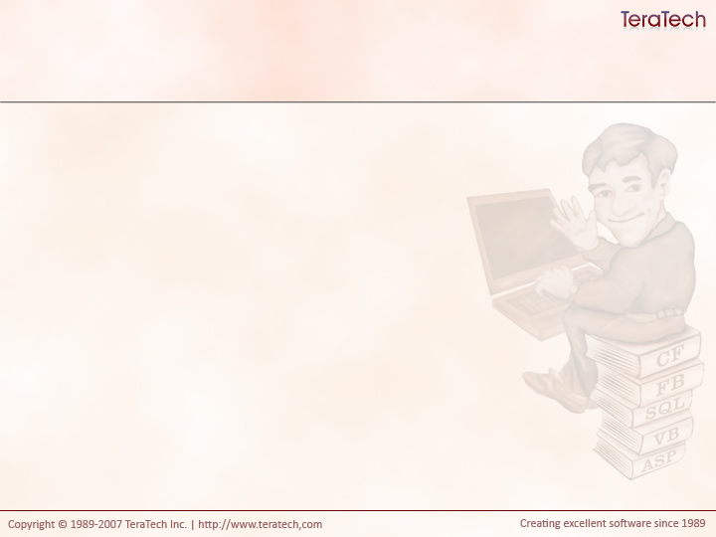
Data Access Design Patterns
Techniques for Success with Data

Slide 2
How do you read data?
cfquery
cffile
cfldap
etc, etc…

Slide 3
Traditional way to Read Data
  <cfquery name="getUsers" datasource="myDSN">
  SELECT *
  FROM Users
  </cfquery>
  <cfoutput query="getUsers">
  <p>#firstName# #lastName#</p>
  </cfoutput>
What’s wrong with this?
  Hard coded DSN
  Query is tied to display logic
    Not reusable
  Mixture of application logic with display logic

Slide 4
Traditional way to Write Data
  <cfquery name="getUsers" datasource="myDSN">
  INSERT INTO User
  (firstname, lastname)
  VALUES
  ("#form.firstname#", "#form.lastname#")
  </cfquery>
What’s wrong with this?
  Hard coded DSN
  Query is tied for form names
    Not reusable
  No query parameters

Slide 5
Common Data Access Actions
Multi-Record Queries
Any sort of ad-hoc query
  SELECT … FROM … WHERE ….
Single Record Queries (Crud)
Create
  INSERT INTO … VALUES …
Read
  SELECT … FROM … WHERE … = X
Update
  UPDATE … SET … WHERE ... = X
Delete
  DELETE FROM … WHERE … = x

Slide 6
Writing Cohesive Components
Which is more cohesive (does one thing well)?
  A component that knows how to read, write, update, delete individual records and knows how to run read multiple rows of data.
  A component that knows how to read, write, update, delete individual records and a second component that knows how to run read multiple rows of data.

Slide 7
Two Common Patterns for Data Access
Table Data Gateways (AKA: Gateways)
  Used to interact with multiple rows of data.
  Typically return queries of data
Data Access Objects (AKA: Daos)
  Know how to persist and read individual objects
  Typically to one object to one record
  CRUD!

Slide 8
Overview of Gateways
Very simple
Methods get data and return it
  Typically use cfquery, but we really don’t care.

